Slide 1

Miners Gonna Mine
Mikhail Kuzin
Senior Malware Analyst, Kaspersky Lab
Mikhail.Kuzin@kaspersky.com
Notes:
Hi! My name is Mikhail Kuzin and I’m working at Kaspersky Lab as a malware analyst, specializing on non-windows malware.
And today we gonna talk about miners. So, why miners you may ask?
Because it’s a very hot topic after all. Because cryptocurrencies gave a brand new way of monetization to cybercriminals. So simple and so efficient! Instead of stealing the credit cards or monetizing via adware.

Slide 2

Money For Nothing guide for dummies
Notes:
And to understand how all that stuff works for the next few minutes let’s think like we are cybercriminals.
So, here is my “money for nothing” guide for you.

Slide 3



Money For Nothing: Options
– no, it’s too hard
Create a real good product and sale it
Prepare a concept of some good product and start ICO
Just go and invest all your money into some perspective crypto coins
Start mining some cryptocurrency
But we need a lot of computing power
Just use not only your own computer!
– no, better than previous, but is still too hard
– no, it’s too risky
– yep, sounds good!
Notes:
Ok, let’s imagine that we are just a greedy junior software developer with big ambitious. What options do we have to earn a lot of money?
First, the most obvious one, create a super cool software and sell it. And it’s not our choice because it’s tricky. You really need to work hard to get a lot of money out of it.
Ok, next option is create a prototype or even just a concept of some good product and start and ICO. This is better because we don’t need to make a full product just concept. But it should be a brilliant idea, otherwise no one would believe in it and send you money.
Another option is just invest all your money into crypto coins. That’s simple. And may be very profitable. But it’s too risky and you need to have enough money for the investment.
And, finally, start mining crypto coins. That’s sounds good, because it’s pretty simple. And not that risky. But we need some computing power. That’s bad. The solution it simple – just use not only your own computer and borrow some power from other people!

Slide 4

Money For Nothing: Plan
Step 0: learn about blockchain and cryptomining
Step 1: choose a platform
Step 2: choose a cryptocurrency
Step 3: choose a mining software
Step 4: make a wallet to use it with the miner
Step 5: implement persistence
Step 6: implement some evasion tricks
Step 7: build your miner and distribute it
...
Profit!
Notes:
So, this is how our way to the Forbs top 10 richest people looks like.
Step 0: learn about blockchain and cryptomining
Step 1: choose a platform for the mining
Step 2: choose a cryptocurrency to mine
Step 3: make a wallet to use it with the miner
Step 4: make a wallet and hardcode it into the miner
Step 5: implement persistence
Step 6: implement some evasion tricks
Step 7: build your miner and distribute it

Slide 5
Step 0: Blockchain
Header
Transactions
Header
Transactions
Header
Transactions
Notes:
Ok, Step 0. What the heck is blockchain? Basically, it’s a chain of blocks ☺ every block in the chain is linked with the previous one. Every block has its header and transactions. Transactions are like “from wallet A to wallet B sent 10 bitcoins”.
Let’s take a closer look at block’s header.

Slide 6
Step 0: Block structure
Field Size | Description | Data type | Comments
4 | version | int32_t | Block version information (note, this is signed)
32 | prev_block | char[32] | The hash value of the previous block this particular block references
32 | merkle_root | char[32] | The reference to a Merkle tree collection which is a hash of all transactions related to this block
4 | timestamp | uint32_t | A Unix timestamp recording when this block was created (Currently limited to dates before the year 2106!)
4 | bits | uint32_t | The calculated difficulty target being used for this block
4 | nonce | uint32_t | The nonce used to generate this block… to allow variations of the header and compute different hashes
? | txn_count | var_int | Number of transaction entries
? | txns | tx[] | Block transactions, in format of "tx" command
Notes:
The most interesting fields here are:
prev_block which is a hash of previous block in the chain. That is what links the blocks so you cannot just replace a block in the middle of the chain.
bits field which regulates the complexity of the mining
and of course nonce field. This is what should be bruteforced by the miners to generate a valid block.
The thing is the hash of the block should be “nice”. Nice means it should have some zeros on the left (the most significant bytes). Let’s move to the next slide to see how it looks like.

Slide 7
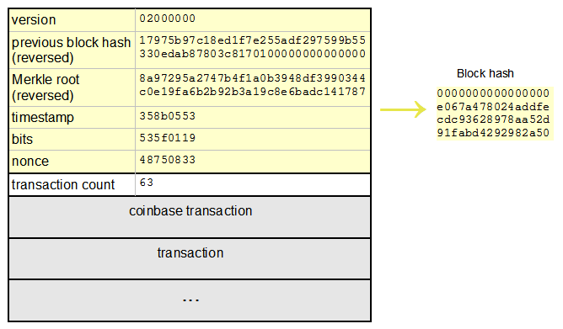
Step 0: Block example
Notes:
That’s how a valid block looks like. On the right is a hash of this block. It has 16 zeros on the left. Hash of the previous block also has some zeros. Note, it’s reversed. So, the amount of zeroes is regulated by the bits field. And the more miners in the network the more computing power it has – the more zeroes would be in the hash.

Slide 8


Step 0: Blockchain summary
Get new transactions and put them into the new block
Fill all known header fields
Bruteforce the “nonce” field until we get “nice” hash
Get your reward!
Notes:
So, the algorithm is simple:
Get new transactions and put them into the new block
Fill all known header fields
Bruteforce the “nonce” field until we get “nice” hash
Get your reward!

Slide 9

Step 1: Platforms
Windows
Linux
MacOS
iOS
Android
Let’s try this one
Notes:
Ok, we’ve learnt the basics. It’s time to choose a platform. Let it be Linux! It has some advantages:
A lot of linux devices: servers, routers, webcams, refrigerators…
Servers usually have good CPU
Servers have various network services -> huge attack surface
Servers usually work all day long (24 hours 7 days in a week)

Slide 10
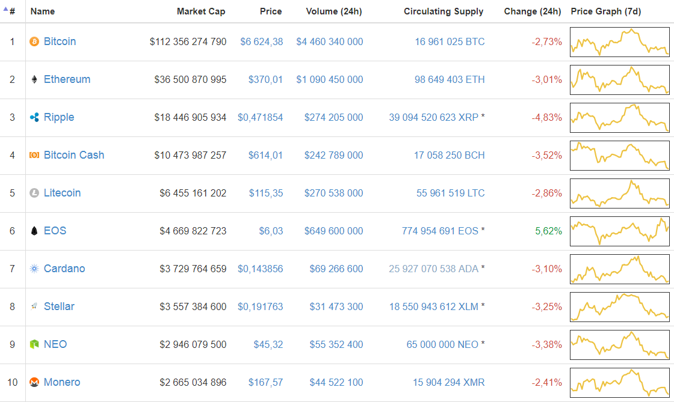
Step 2: Cryptocurrencies
Notes:
The next step is to choose crypto coins that we are going to mine. Here is the top 10 list of crypto coins by the market capitalization. And of course the most obvious choice is bitcoin. But is it good for our purpose? Let’s figure out.

Slide 11
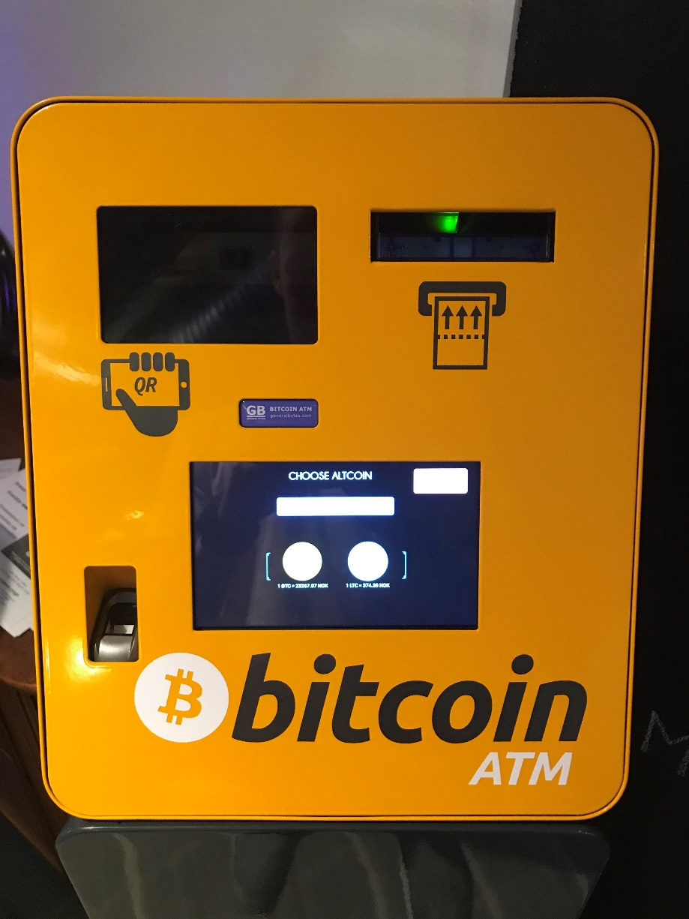
Step 2: Bitcoin
Pros:
Father of all cryptocurrencies
A lot of open-source mining software
Even Bitcoin ATMs exist
Cons:
Slow transactions
High transaction fee
Easy to trace a transaction
Better mine on GPUs or ASICs
Notes:
So, the good thing about bitcoin is:
It’s the first crypto currency. So, it’s the most stable and most popular
A lot of open-source mining software
Even Bitcoin ATMs exist
But the bad things are:
Slow transactions – 10 mins
High transaction fee
Easy to trace a transaction
Better mine on GPUs or ASICs

Slide 12





Step 2: Bitcoin transaction tracing
Mining reward
Withdraw cash
10 BTC
Blockchain
Notes:
So, if we would use bitcoin all the scheme would be like:
We distribute our miner and now thousands of the computers mine for us. We receive mining reward to some wallet. Next, we need to transfer our money to some crypto stock exchange. And this transaction of course would be saved in the block chain. Next we will withdraw cash exchanging our BTC to USD and sending them to our credit card. And become so damn rich! And probably go to jail… Because everybody can find the transaction in the block chain and link the mining wallet with the one we withdraw from.

Slide 13

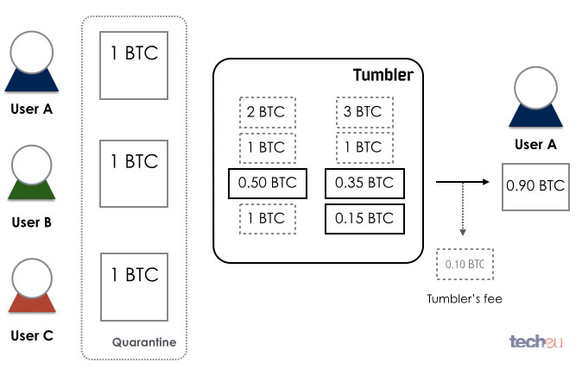
Step 2: Bitcoin tumbler
Notes:
There is a solution for this problem: mixing services or in other words – tumblers. Such services allows you not to send money directly to another wallet but using many other wallets. This is like:
User A sends 5 BTC to mixing service saying “hey, this for user B”. Mixing service then just send to user B 1 BTC from one wallet 2 BTC from another one and 2 BTC from one more wallet. In sum there’s still 5 BTC sent to user B. Not actually five, because the service gets its fee, so it would be like 4,95 BTC.
So, the problem is solved. But it looks like a third wheel for a bicycle. And remember we are greedy. And of cause we don’t want to share our reward with some service.

Slide 14
Step 2: Built-in tumblers
Cloakcoin
PIVX
Dash
Zcoin
Notes:
Of cause, now there are some coins with built-in tumblers. This is good. But there’s something better.

Slide 15
Step 2: Monero vs Bitcoin
Provides anonymity by design, without mixing services
Even transaction amounts are encrypted
Uses CryptoNight proof of work hash algorithm
Mining on CPU is profitable
Resistant to application-specific integrated circuit (ASIC) mining
One of the Top-10 coins by market capitalization
It’s pretty popular => won’t disappear in a moment
Especially among cybercriminals ☺
Transaction fee is smaller and transactions are faster
A lot of open source mining software
Notes:
A crypto currency called Monero. What does make it so special?
Provides anonymity by design, without mixing services
Even transaction amounts are encrypted to prevent transactions from being traced by the amount sent
Uses CryptoNight proof of work hash algorithm
Mining on CPU is profitable
Resistant to application-specific integrated circuit (ASIC) mining
One of the Top-10 coins by market capitalization
It’s pretty popular => won’t disappear in a moment
Especially among cybercriminals ☺
Transaction fee is smaller and transactions are faster
A lot of open source mining software

Slide 16
Step 2: Monero vs Bitcoin
 | Monero | Bitcoin
Release date | 18 April 2014 | 9 January 2008
Blockchain protocol | Proof of work | Proof of work
Trackable | No | Yes
Transaction fee | 0.004-0.02 XMR | Based on load on blockchain
Algorithm | CryptoNight | SHA-256 (x2)
Blocks time | 120 seconds | At least 10 minutes
Mining | CPU, GPU | GPU, ASIC miners
Notes:
Here is the comparison of these crypto coins.
Monero is newer.
Both of them use proof-of-work protocol. Basically, that means you can mine both of them. By default bitcoin is trackable, monero is not. Monero transaction fee is lower and transactions are faster because bitcoin blockchain is overloaded, so the fees are pretty high. For counting hash of the block bitcoin uses SHA-256 twice. Monero uses Cryptonight hash algorithm that works fast on CPUs and GPUs and was designed to work slower on ASICs. That means Monero blockchain would not be so overloader as bitcoin’s one.

Slide 17
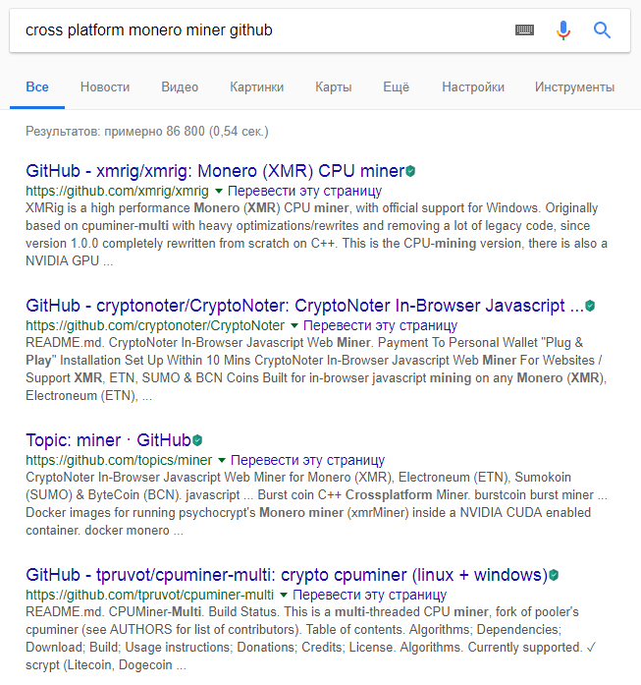
Step 3: Mining software
Let’s use this one
Notes:
Ok, we finished with the crypto currency. Monero is pretty good for our purposes. Now let’s choose the mining software. You can just google it. All of the top 10 results are suitable but let’s pick this one called cpuminer.

Slide 18
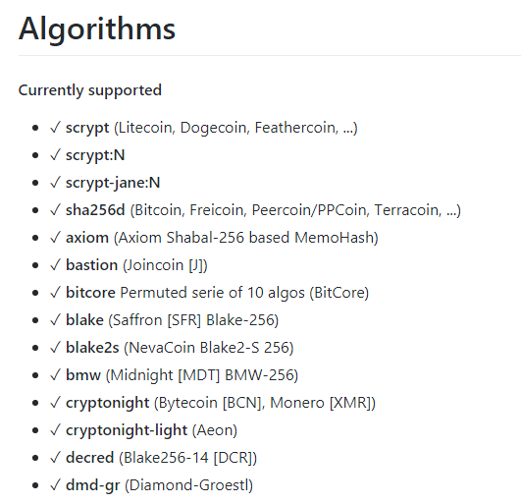
Step 3: Mining software
Notes:
We can check on its github page that it supports monero mining. Yes, it does.

Slide 19
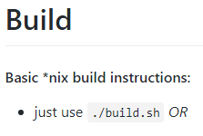
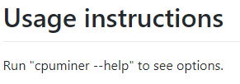
Step 3: Mining software
Notes:
Besides, it needs some dependencies. We can install them with the first command bash command if we are using Ubuntu for compilation. To build it we just need to run build.sh file. And all of the available options you can see using a key “–help”.

Slide 20
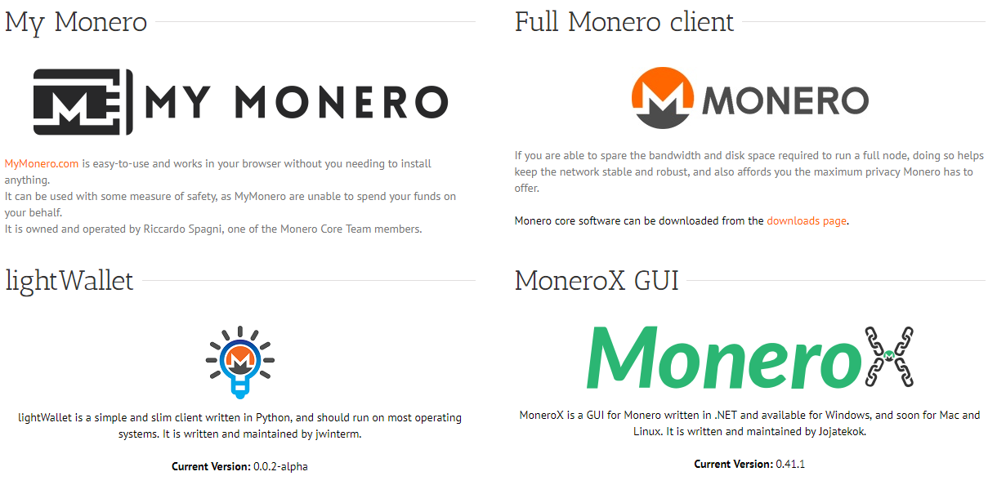
Step 4: Wallet
Let’s be lazy ☺
Notes:
The next step is to register the wallet. You can choose from various monero wallet services.
But let’s choose the most fast and easiest way. Remember money for nothing rule: less work, more money.

Slide 21
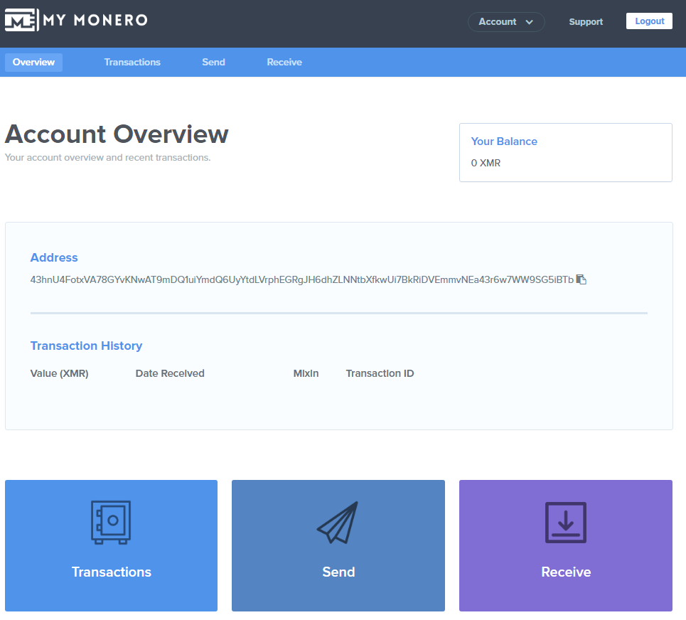
Step 4: Wallet
Notes:
And that’s how your wallet looks like. As you can see I didn’t even blur my wallet address. That’s because I still don’t have any money on it and I hope someone will send me some. Just kidding…

Slide 22

Step 4: Wallet
Now we have some problems:
We don’t want to hardcode our wallet address into the miner
Solo mining is inefficient due to low hash rate
Decision: mining pools!
Notes:
Now we have some problems. First, we don’t want to hardcode our wallet address into the miner because everyone would be able to see how much money we have. The second, obviously, solo mining is inefficient due to the low hash rate. But there is a solution for these problems and it’s mining pools.

Slide 23

Step 4: Mining pools
Only the one who creates a valid block get the reward
The more hash rate you have, the more likely you get the reward
People start to unite into pools to get more hash rate
And then they just share the reward according to contribution of each participant
Notes:
So, mining pools.
Only the one who create a valid block get the reward
The more hash rate you have, the more likely you get the reward
People start to unite into pools to get more hash rate
And then they just share the reward according to contribution of each participant

Slide 24
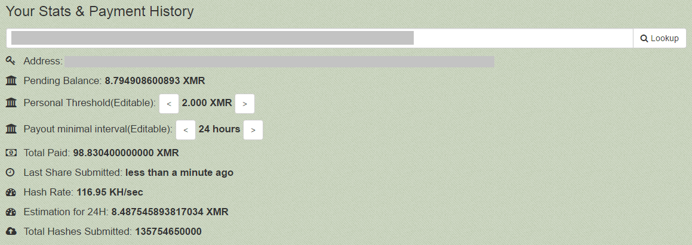
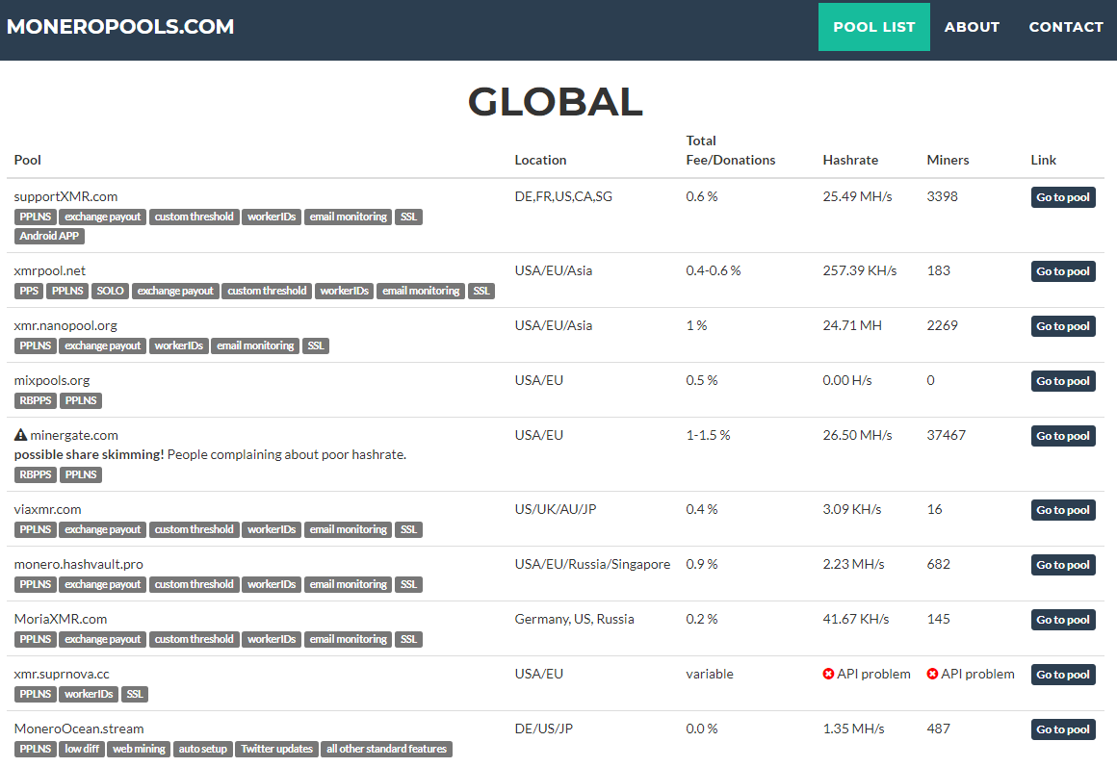
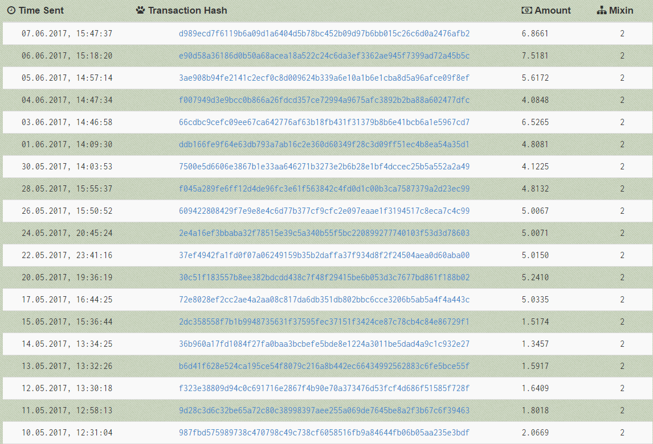
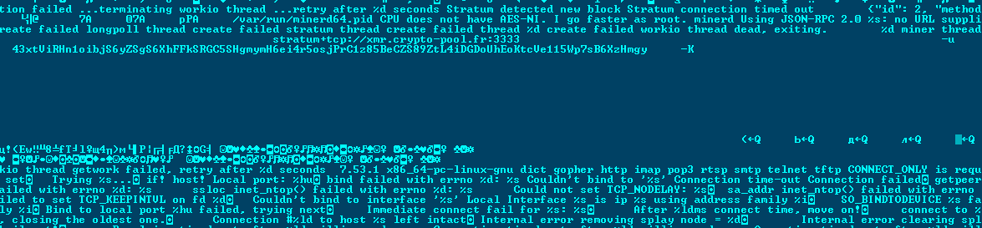
Step 4: Mining pools
monero.crypto-pool.fr
Notes:
There are a lot of mining pools. You can use this web site to choose the one you like. Just remember: the more hash rate it has the more likely you get a reward. And of cause the pool gets its fee from every reward that miners get.
But for us it is also important to stay anonymous and not use our wallet address. Because some researchers can easily find it inside the binary file. And find out how much money we’ve earned.

Slide 25

Step 4: MinerGate
All you need to sing up is a e-mail address
This e-mail address would be used as a parameter for the miner instead of the wallet
The pool does not have an option to get the wallet info by user’s email
Notes:
So, one of the best choices would be minergate pool. Because:
All you need to sing up is a e-mail address
This e-mail address would be used as a parameter for the miner instead of the wallet
The pool does not have an option to get the wallet info by user’s email
And that is cool.

Slide 26
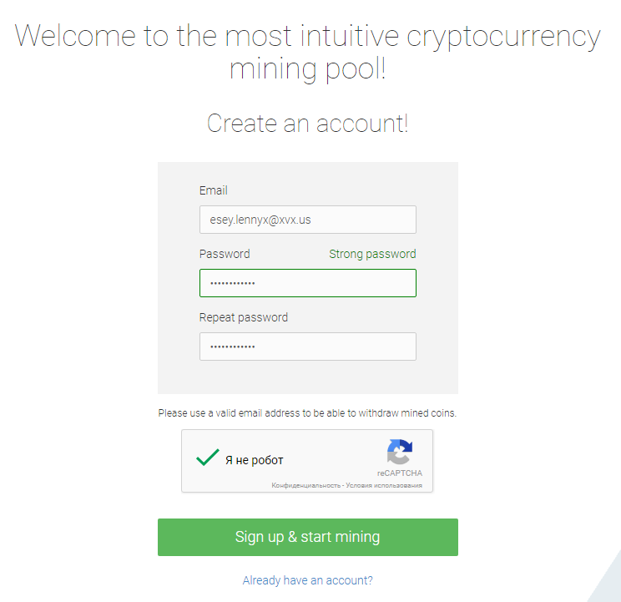
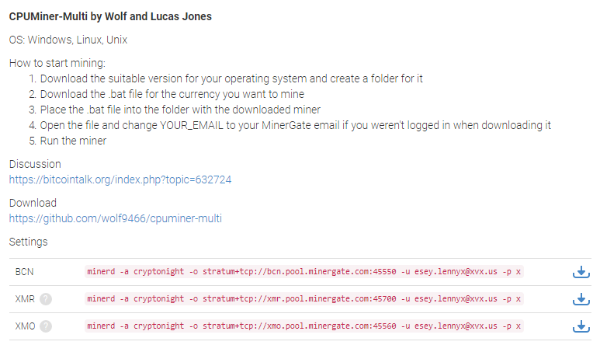
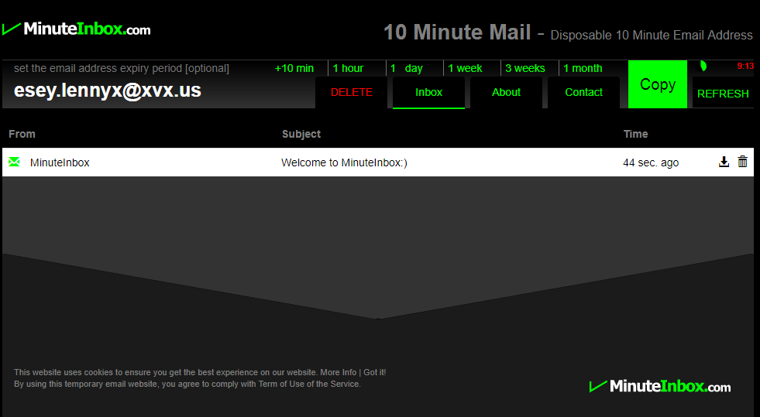
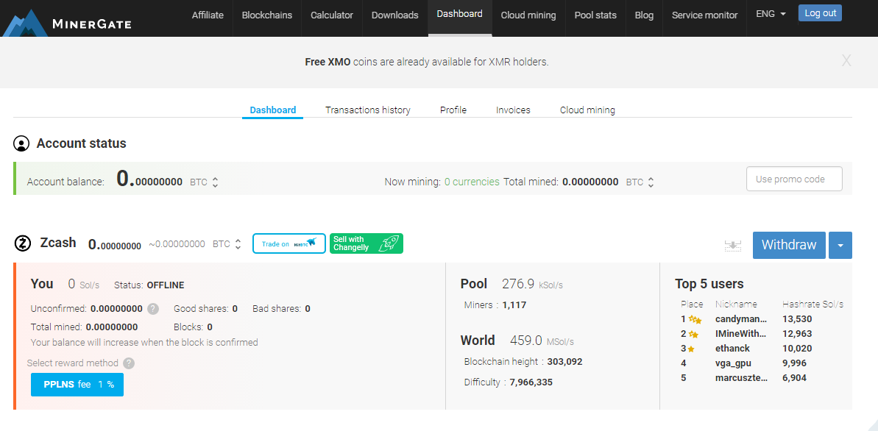
Step 4: MinerGate
Notes:
This is how the registration process looks like. We need some email address. You can use a one minute email for that because we will not need it in the future. Than just use it, come up with the password, solve the captcha and that’s it. This is how our dashboard looks like. We can withdraw the coins from the pool to another wallet. And we can find the information how to start mining using minergate on the help’s page. So, no wallet, just a email.

Slide 27
Step 5: Persistence
cron, at
crontab <<< "* * * * * /tmp/.evil_miner"
~/.bash_profile, ~/.bashrc
echo "/tmp/.evil_miner" >> ~/.bashrc
init.d, /etc/rc.local (root)
update-rc.d startminer defaults
/etc/rc5.d/S58startminer -> ../init.d/startminer
/etc/ld.so.preload
Notes:
Well, now some technical aspects. We need some persistence for our miner, so it should run after the reboot and so on. Just remind you, currently we are talking about Linux because each OS has its own persistence mechanisms.
So, what do we have?
Task schedulers like cron. We can start our miner every minute. And check whether the miner is already running or not inside the miner
We can use bashrc - when an interactive shell that is not a login shell is started, bash reads and executes commands from it.
We can use init.d. This is more tricky than 2 previous. And we need root permissions to do that. But it’s a bit more stealthy than 2 others and doesn’t depend on the user.
Some more advanced thing is ld.so.preload. We need to specify a path to the library that would be injected into every starting process in the system. But in the case we need to build miner as a library.

Slide 28
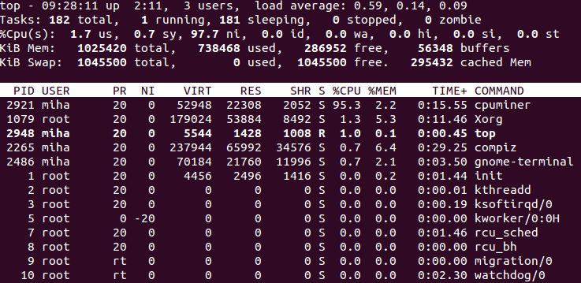
Step 5: Evasion
Hide 100% CPU usage
Kill other miners and security solutions
Notes:
And what’s about evasion? We want our miner to be stealthy so it mines as much as it can. The first problem we need to solve is how to hide high CPU usage because it’s very noticeable and suspicious. For example we can monitor what processes are currently running and stop mining activities if we detect some process explorer like ps or top utilities.
Also we don’t want other miners to mine on the same machine because it would be inefficient. So we can just find them and kill them. We’ll see how to do it later. Also we can try to kill running security solutions like antiviruses but for linux for don’t really need it.

Slide 29


Step 5: Distribution
Spam
Adware
Cracked apps
Social Engineering tricks (fraud)
Vulnerability exploitation
Notes:
And last but not least, distribution. We need to deliver our miner to as many machines as we can.
There are several ways to do that:
We can do just a spam mailing
We can hide our miner under the guise of some useful software and use some advertisements to spread it
We can hide our miner under the guise of some cracked app and distribute it via torrents for example
Also we can use some Social Engineering tricks (fraud)
Vulnerability exploitation

Slide 30

Notes:
That’s it for our miner. And if you are feeling like this leopard right now I have good news for you – no more theory, let’s move on to some real cases.

Slide 31
ITW Cases: Linux

Slide 32

EternalMiner: Overview
Trojan-Downloader.Linux.EternalMiner
Discovered in May 2017
Distributed via vulnerability in Samba server (EternalRed, CVE-2017-7494)
In addition to the miner they also installed a reverse shell
Notes:
Story about ShadowBrokers, WannaCry and honeypot.

Slide 33
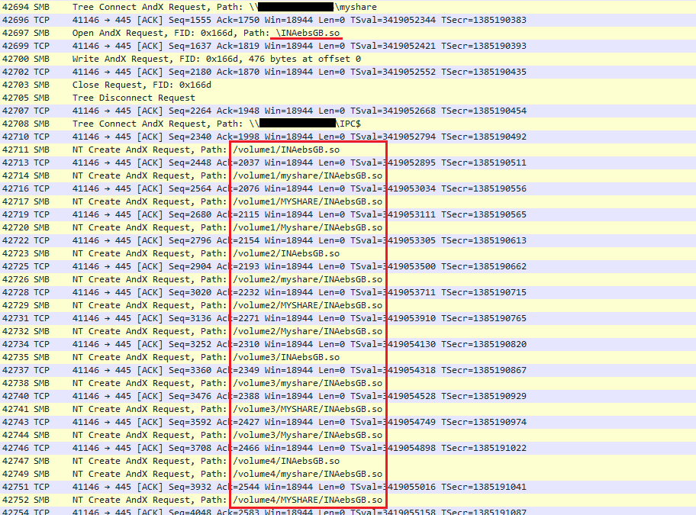
EternalMiner: Distribution
Upload the files to Samba share
INAebsGB.so – reverse shell
cblRWuoCc.so – miner downloader
Bruteforce the path to the payload
Use the exploit to execute the files
In the context of samba server process
Delete the files
To hide the traces
Notes:
After successful exploitation, the file runs with super-user privileges, although first the attackers have to guess the full path to the dropped file with their payload, starting from the root directory of the drive. We can see such attempts in the traffic captured on our honeypot. They are just brute-forcing the most obvious paths (specified in different manuals, etc.), where files can be stored on the drive.
After the path to the file is found, it can be loaded and executed in the context of the Samba-server process, using the SambaCry vulnerability. Afterwards the file is deleted in order to hide the traces. From this moment it exists and runs only in the virtual memory.

Slide 34
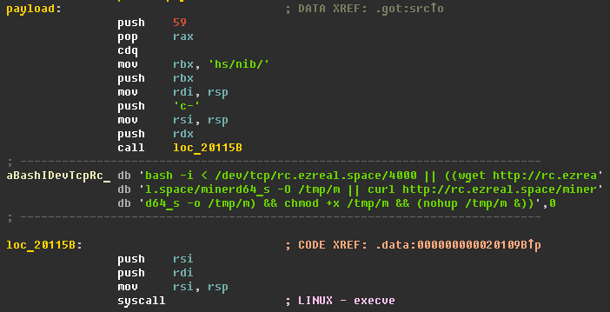
EternalMiner: Distribution
Notes:
Miner downloader just executes a shell script which simply downloads a customized miner into the tmp folder and starts it.

Slide 35

EternalMiner: Persistence and evasion?

Slide 36
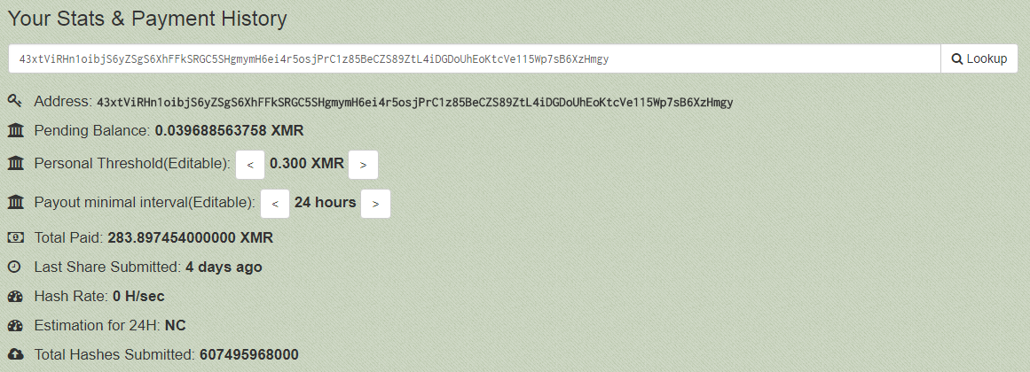
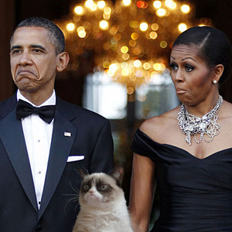
EternalMiner: Mining
Miner: modified cpuminer with hardcoded arguments
Cryptocurrnecy: Monero (XMR)
Mining pool: https://monero.crypto-pool.fr/
~ 40,000 USD
Notes:
Not a good choice of mining pool. Ok, let’s take a look… (exchange rate ~166$)

Slide 37
Just Another Miner: Distribution
Discovered in February 2018
Distributed through vulnerability in Oracle WebLogic Server < 12.2.1.2.0 (CVE-2017-10271)
Version for windows also exists
And through Weathermap PHP plugin <= 0.97a vulnerability (CVE-2013-2618)
https://blog.trendmicro.com/trendlabs-security-intelligence/cryptocurrency-miner-distributed-via-php-weathermap-vulnerability-targets-linux-servers/

Slide 38
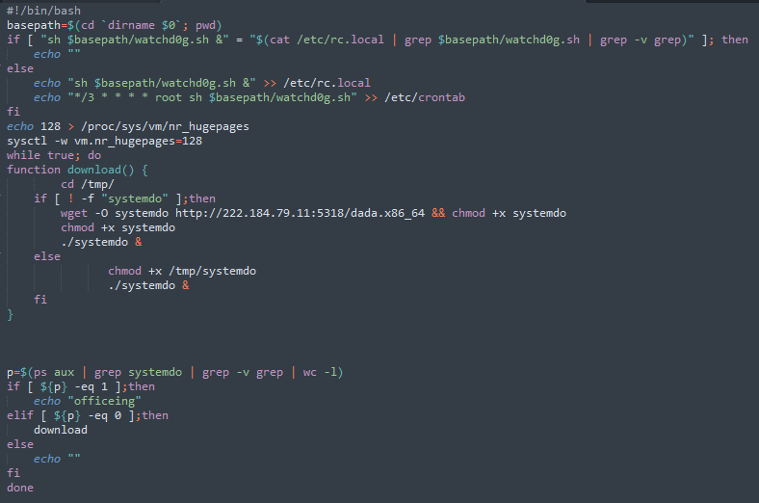
Just Another Miner: Persistence
Notes:
It uses /etc/rc.local file and cron for persistence.

Slide 39
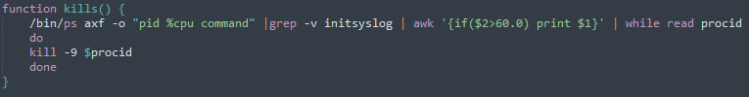
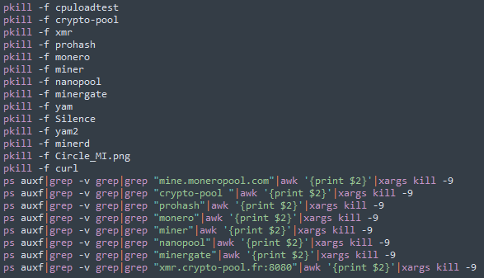
Just Another Miner: Evasion
Notes:
Kills every process which loads cpu greater than 60 %
Kill the processes which command line args contains one the following lines

Slide 40

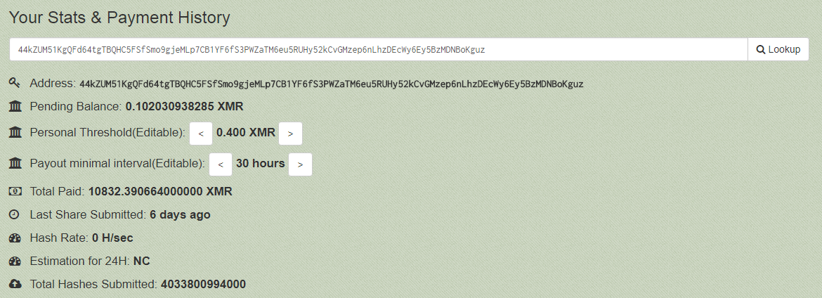
Just Another Miner: Mining
Miner: Modified version of XMRig
Cryptocurrency: Monero
Mining pool(s): pool.supportxmr.com:80, pool.minexmr.com:443, xmr.crypto-pool.fr:443
~1,800,000 USD
Notes:
Let’s take a look at one of the wallets they used in the malware…

Slide 41
ITW Cases: Android

Slide 42
Loapi: Overview
Trojan.AndroidOS.Loapi
Discovered in December 2017
It has a complicated modular architecture
That means it can conduct a variety of malicious activities

Slide 43
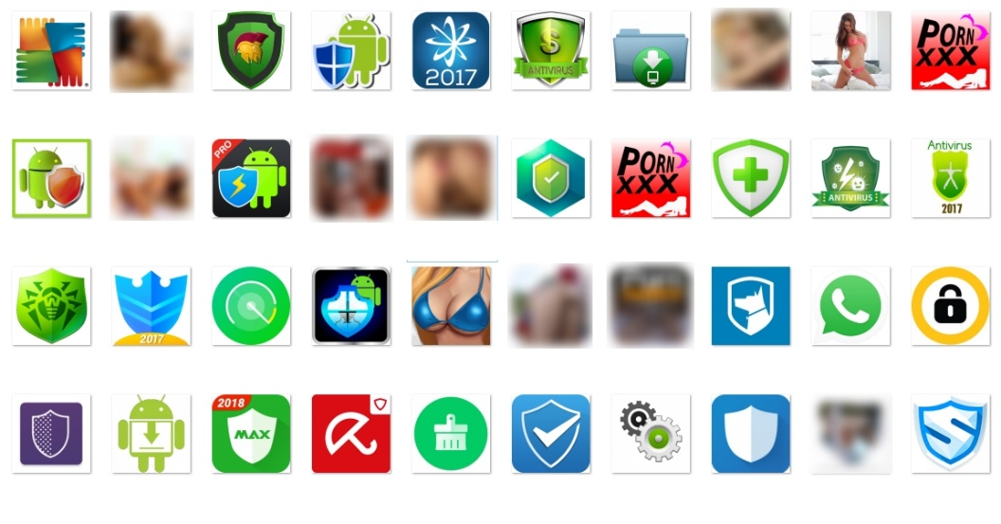
Loapi: Distribution
Distributed via advertising campaigns
Malicious files are downloaded after the user is redirected to the attackers’ malicious web resource
More than 20 resources, whose domains refer to popular antivirus solutions and porn sites
So, it mainly hides behind the mask of antivirus solutions or adult content apps

Slide 44
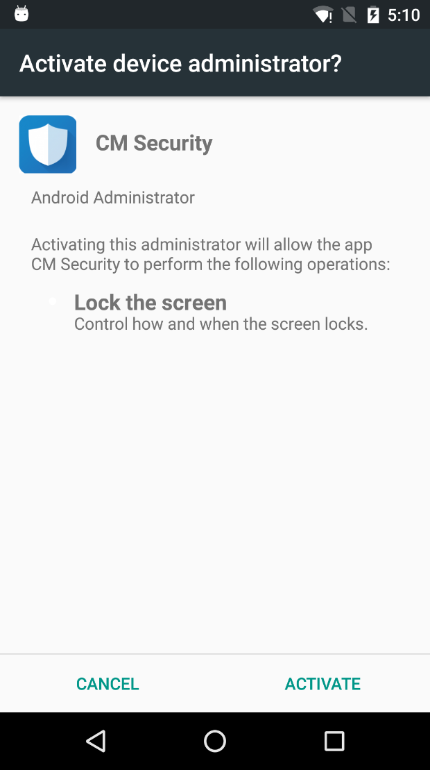
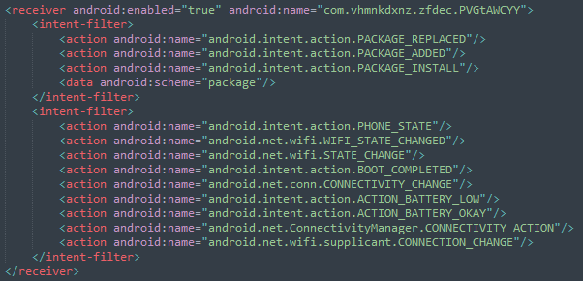
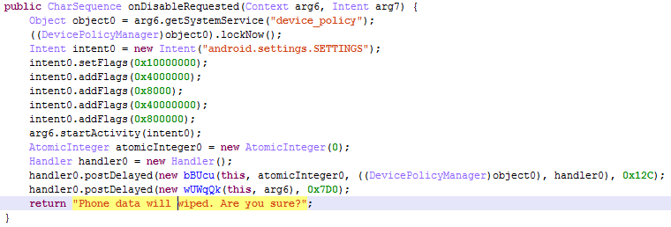
Loapi: Persistence
After the installation it tries to obtain device administrator permissions
Asking for them in a loop until the user agrees
Just locks the screen if the user tries to remove it from device admins
It starts when:
User gets a call or calling to someone
Wi-Fi state changes
Mobile data state changes
The device turns on
Battery is low/okay
Notes:
The thing is that you can’t just uninstall an application with device admin permissions. First, you need to remove it from the device admins list.
On Android an app can subscribe to various system events and execute appropriate receivers when such an event occurred.

Slide 45
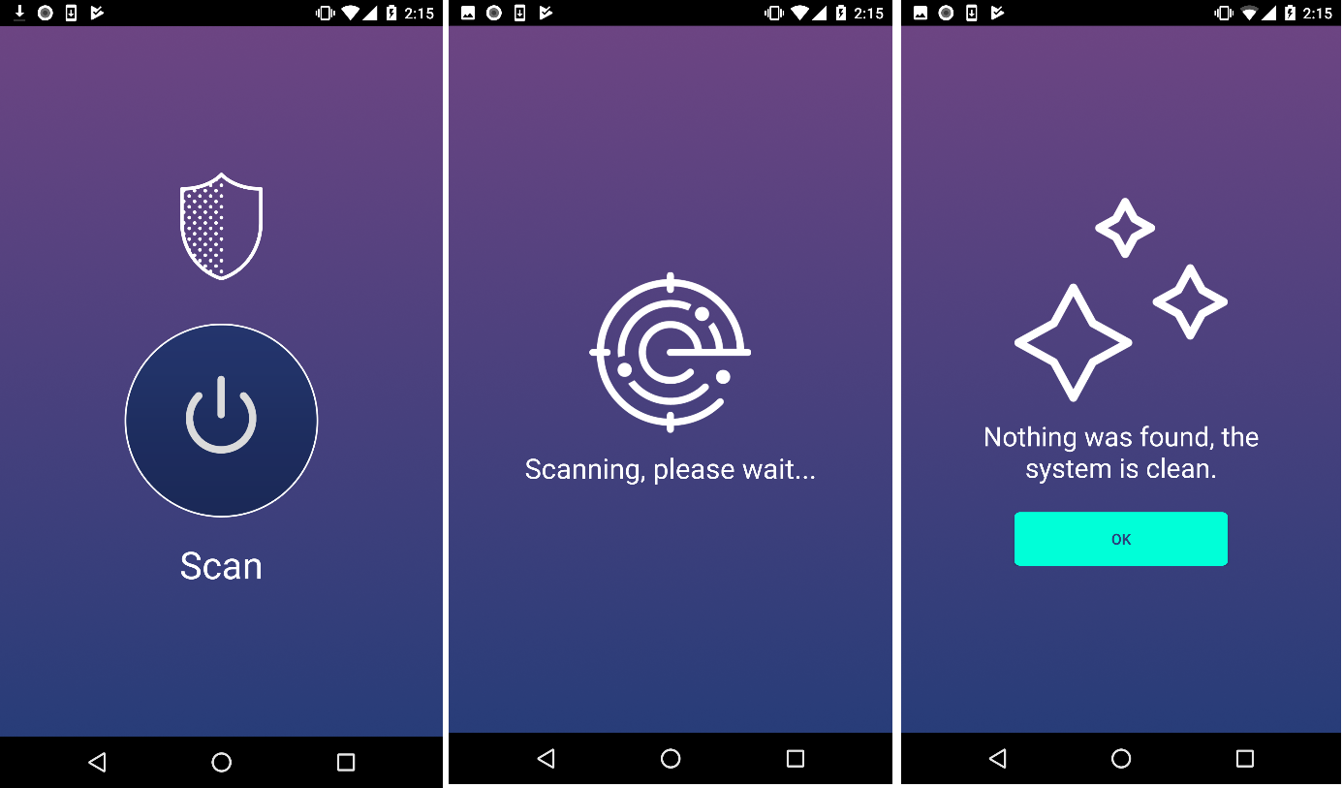
Loapi: Evasion
Next, the Trojan either hides its icon in the menu
Or simulates various antivirus activities
Depending on the type of application it masquerades as

Slide 46
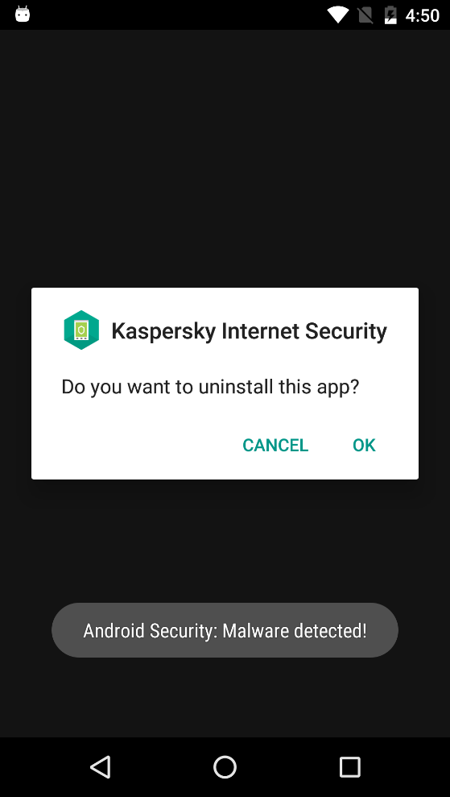
Loapi: Evasion
Receives a list of apps that pose a danger to it from the C&C server
Monitors the installation and launch of those apps
If one of the apps is installed or launched, it shows a fake message claiming it has detected some malware
And, of course, prompts the user to delete it
BTW, this message is shown in a loop
Until the user finally agrees and deletes the application ¯ \ _ (ツ) _ / ¯

Slide 47
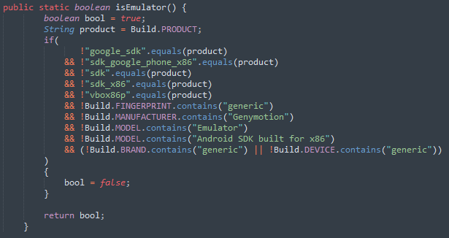
Loapi: Evasion
It does’t like Android emulators and sandboxes

Slide 48
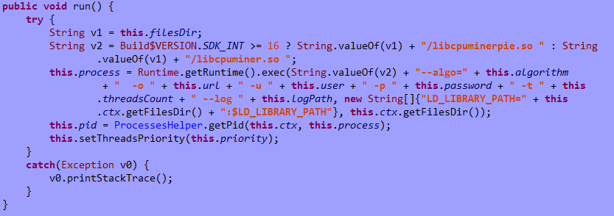
Loapi: Mining
It uses the Android version of cpuminer to mine Monero (XMR)
Starts miner with the following arguments:
Mining pool: “xmr.pool.minergate.com:45560”
Username, randomly selected from the list: “lukasjeromemi@gmail.com”, “jjopajopaa@gmail.com”, “grishaobskyy@mail.ru”, “kimzheng@yandex.ru”, “hirt.brown@gmx.de”, “swiftjobs@rambler.ru”, “highboot1@mail333.com”, “jahram.abdi@yandex.com”, “goodearglen@inbox.ru”, girlfool@bk.ru
Password, constant value: “qwe”
Notes:
So, unfortunately we can’t check how much coins it mined.
During our research of this malware we use a real Android device for dynamic analysis. And…

Slide 49
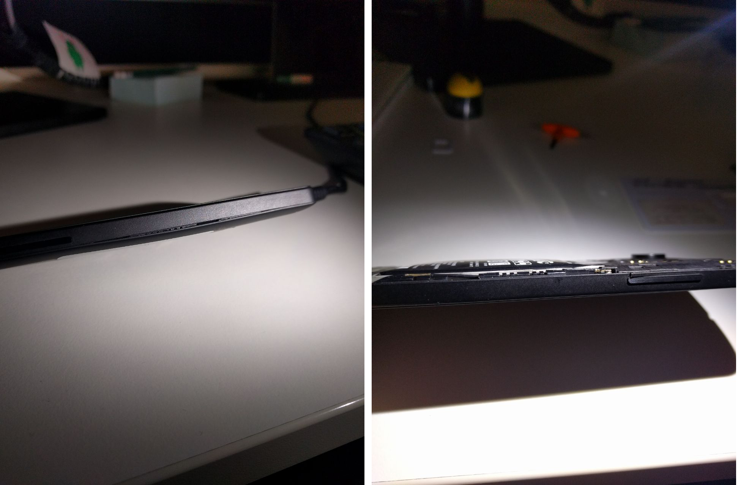

Loapi: Mining
Notes:
… now it looks like this. The image shows what happened to it after two days of mining. Because of the constant load caused by the mining module, the battery bulged and deformed the phone cover.

Slide 50
ITW Cases: MacOS

Slide 51
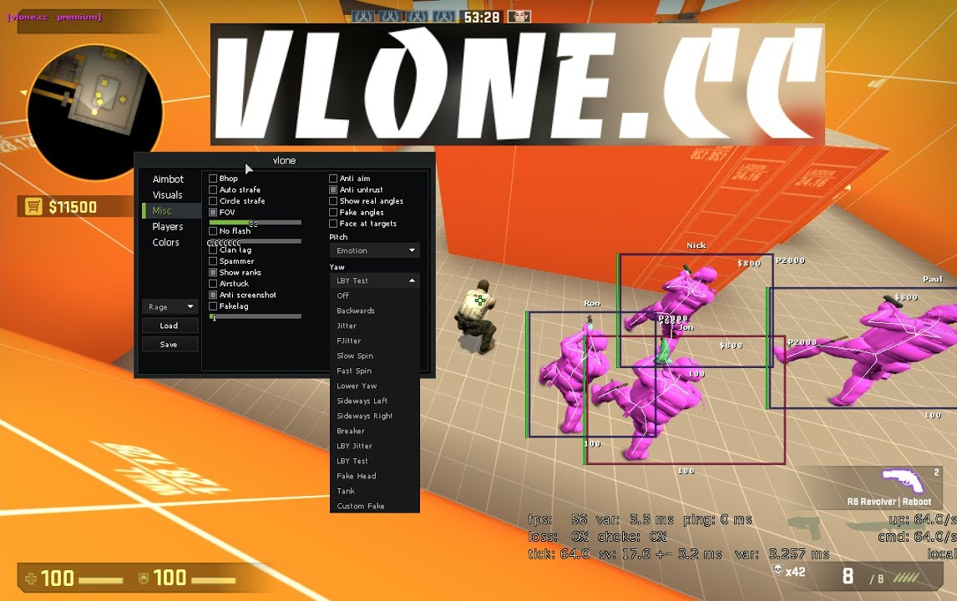
Pwnet: Distribution
Discovered in August 2017
Distributed as Counter-Strike: Global Offensive hack from vlone[.]cc

Slide 52
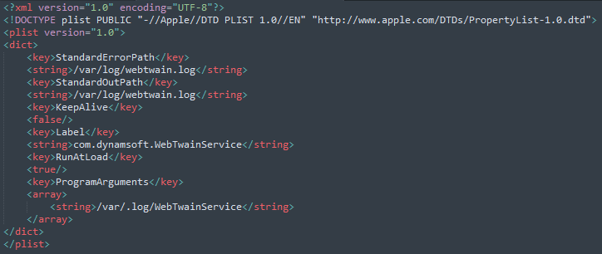
Pwnet: Persistence
The installer puts a watchdog’s plist into /Library/LaunchDaemons/ and registers it with launchctl
The watchdog runs the backdoor every hour
The backdoor communicates with its CnC and starts/stops a miner with appropriate arguments
Notes:
… There was an installer for this hack. And besides it really installs a real hack for CS:GO it also drops some malicious files.
Property lists are regular xml files which are used frequently in macOS for various purposes. The one used by the malware is demonstrated on the slide.
Launchctl is an utility that is used to manipulate the daemon called Launchd. Launchd, like initd in Linux, is the first userspace process launched by the kernel during booting process in macOS. And thus it is the parent process for all userspace processes in macOS.

Slide 53
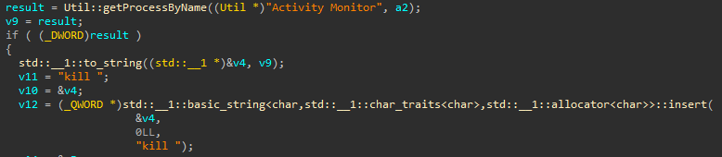
Pwnet: Evasion
The backdoor checks if “Activity Monitor” is running
Kills it

Slide 54
Pwnet: Mining
Miner: MinerGate CLI
Cryptocurrency: Monero
Mining pool: minergate.com
Args: -user pwnedboi@protonmail.com --xmr 2

Slide 55
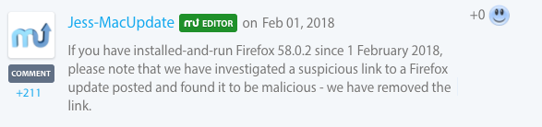
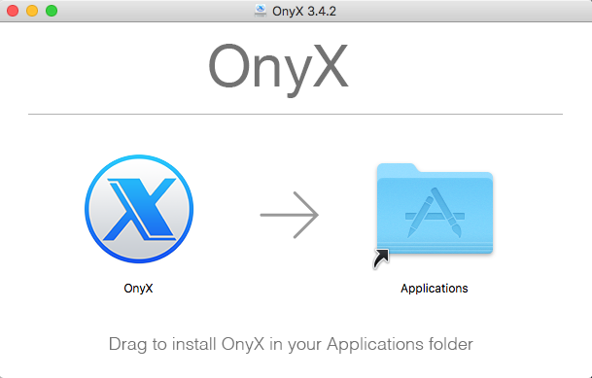
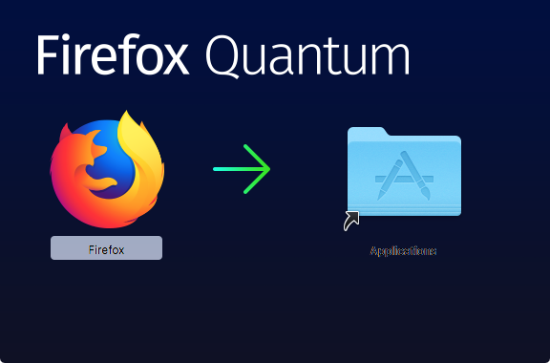
MinerUpdate: Distribution
From MacUpdate site as modified versions of Firefox, OnyX and Deeper apps

Slide 56
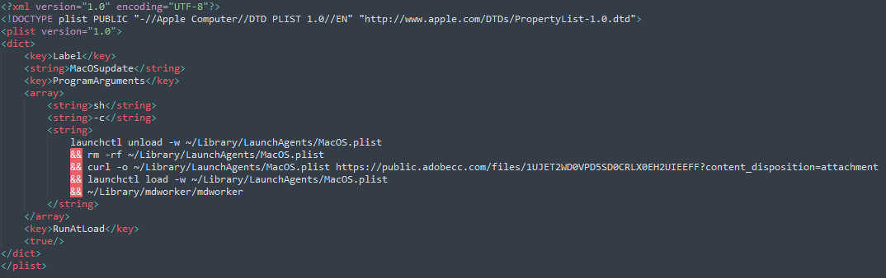
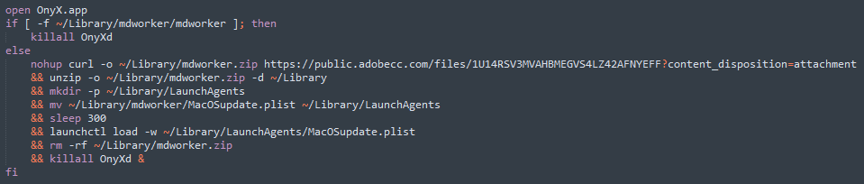
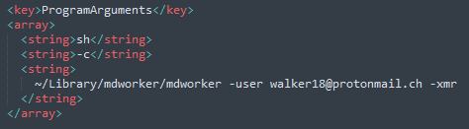
MinerUpdate: Persistence
Puts MacOSupdate.plist into ~/Library/LaunchAgents/LaunchAgents and registers it
MacOSupdate.plist downloads MacOS.plist and puts it into ~/Library/LaunchAgents/LaunchAgents
MacOS.plist starts the miner

Slide 57
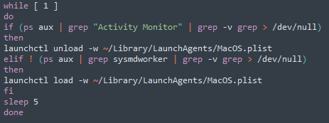
MinerUpdate: Evasion
It stops the miner if Activity Monitor is running
And launches it if Activity Monitor and the miner are not running

Slide 58
MinerUpdate: Mining
Miner: MinerGate CLI
Cryptocurrency: Monero
Mining pool: minergate.com
Args:
-user sarahmayergo1990@gmail.com –xmr
-user walker18@protonmail.ch -xmr

Slide 59
ITW Cases: Windows

Slide 60
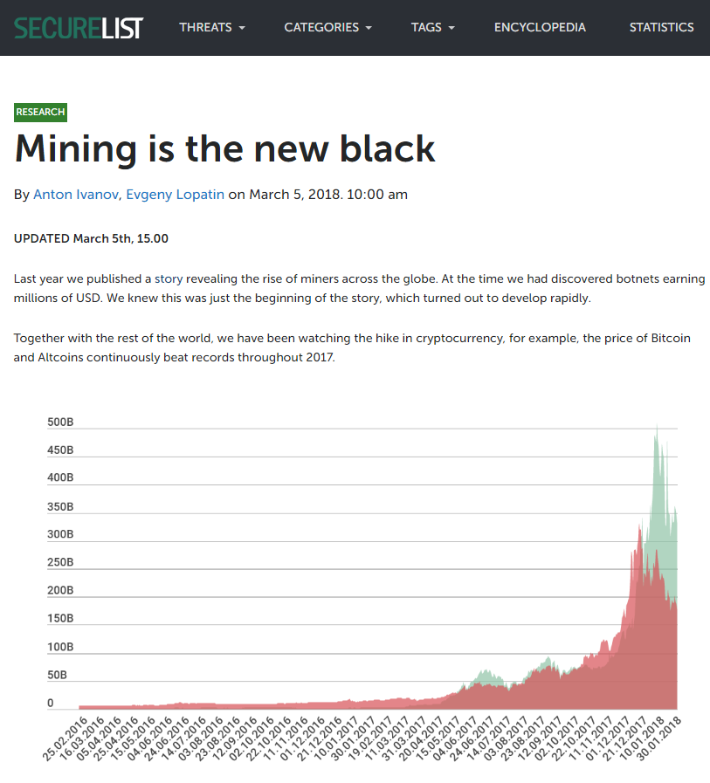
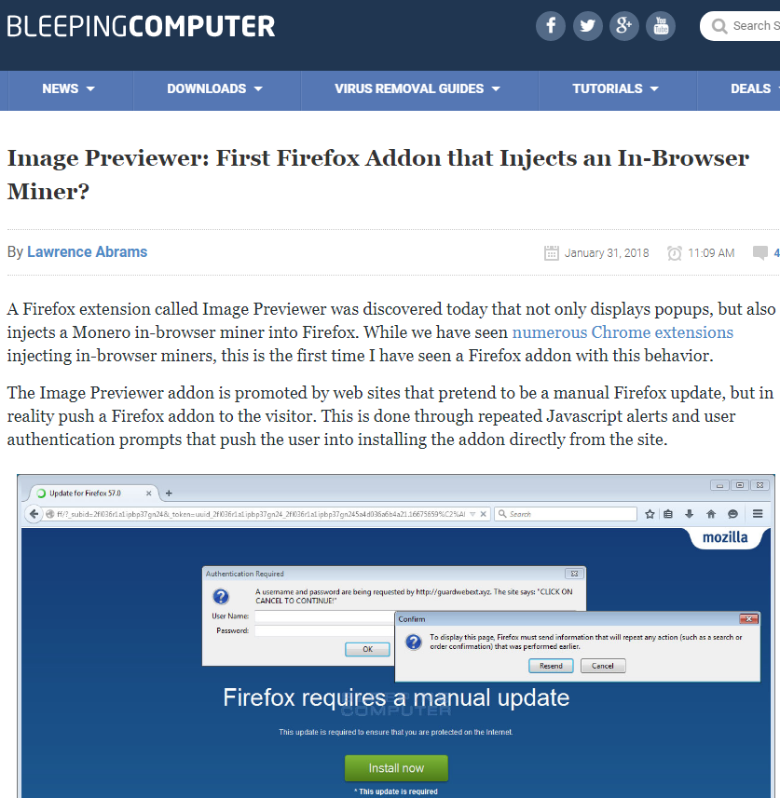
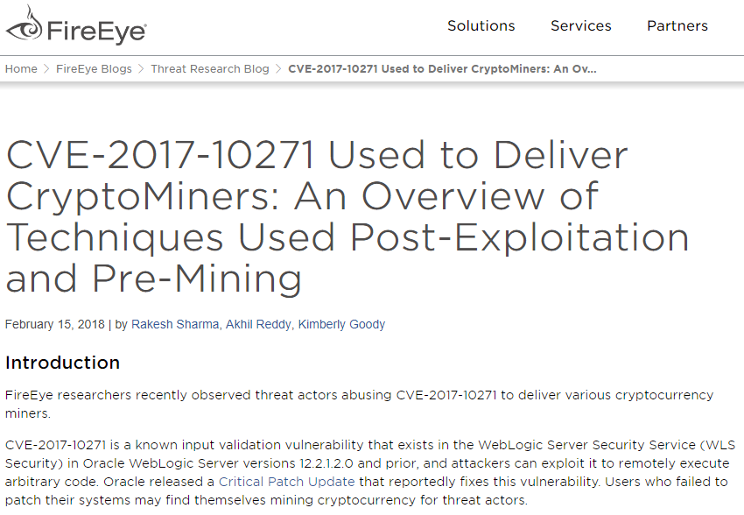
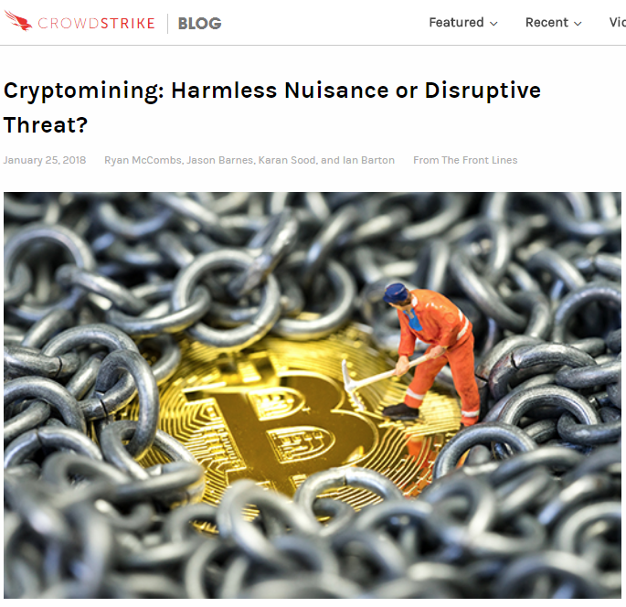









So much cases
Notes:
… And you can even mine on Microsoft HoloLens! My colleagues made a proof-of-concept for that and showed it at Security Analyst Summit this year.

Slide 61


Slide 62
CoinHive

Slide 63
CoinHive: What is it?
Monero mining web service
Can be deployed on a website using JavaScript
Or injected into the traffic ☺
So, mining in the browser using user’s CPU
Originally developed as an alternative to advertising revenue

Slide 64




CoinHive: Distribution
Content from browser
Hacked web pages with big traffic
Infected ads
Browser games

Slide 65



CoinHive: Infected websites
Notes:
PirateBay infected with coinhive
YouTube ads contains coinhive mining code
UFC site infected with a miner

Slide 66

CoinHive: Starbucks Wi-Fi
Place: Buenos Aires Starbucks
In-store provider forces a 10 second delay when you first connect to the Wi-Fi so it can mine some Monero
Notes:
Buenos Aires

Slide 67


CoinHive: CoffeeMiner
CoinHive injection proof-of-concept
Public Wi-Fi + ARP Spoofing + mitmproxy + coinhive injection = love :)
https://arnaucode.com/blog/coffeeminer-hacking-wifi-cryptocurrency-miner.html

Slide 68



CoinHive: Android apps
AppInventor Framework – create an Android app using only html/js
Just a meme generator?
Or not?

Slide 69
Bonus Track

Slide 70

Unusual Schemes
Using botnet to pump shitcoins
Necurs, was sending millions of spam emails that push an obscure cryptocurrency named Swisscoin (15 Jan 2018)
Notes:
Necurs - the world's largest spam botnet

Slide 71

Unusual Schemes
Hacking Claymore Miner through its management service (port 3333) to replace the wallet address in the config
Notes:
the Claymore Miner Windows version provides a remote monitoring and/or management interface on port 3333. And by default earlier versions allow not only remote reading for mining status, but also operations like restart, upload files and some other control operations.

Slide 72

Unusual Schemes
Cryptoransom Trojan distributed under the guise of the wallet of non-exisiting cryptocurrency - SpriteCoin

Slide 73

Let’s Talk?
Kaspersky Lab HQ
39A/3 Leningradskoe Shosse
Moscow, 125212, Russian Federation
Tel: +7 (495) 797-8700
www.kaspersky.com

